Slide 1
Digital Business and E-Commerce Management
Lesson 9
Setting a Shopify Site (B2C) Part 3

Slide 2
Setting a Shopify Site (B2C) Part 3
At the end of this lesson, you will be able to
Manage Product Collections, Transfers, Inventories and Gift Cards
Manage blog posts
Customize and configure other Shopify Settings
Manage orders and customers
Familiar on how to buy a custom domain
Understand Analytics, Marketing, Discounts and Adding App

Slide 3
Activity 9.1
Refer to your book for Activity 9.1

Slide 4
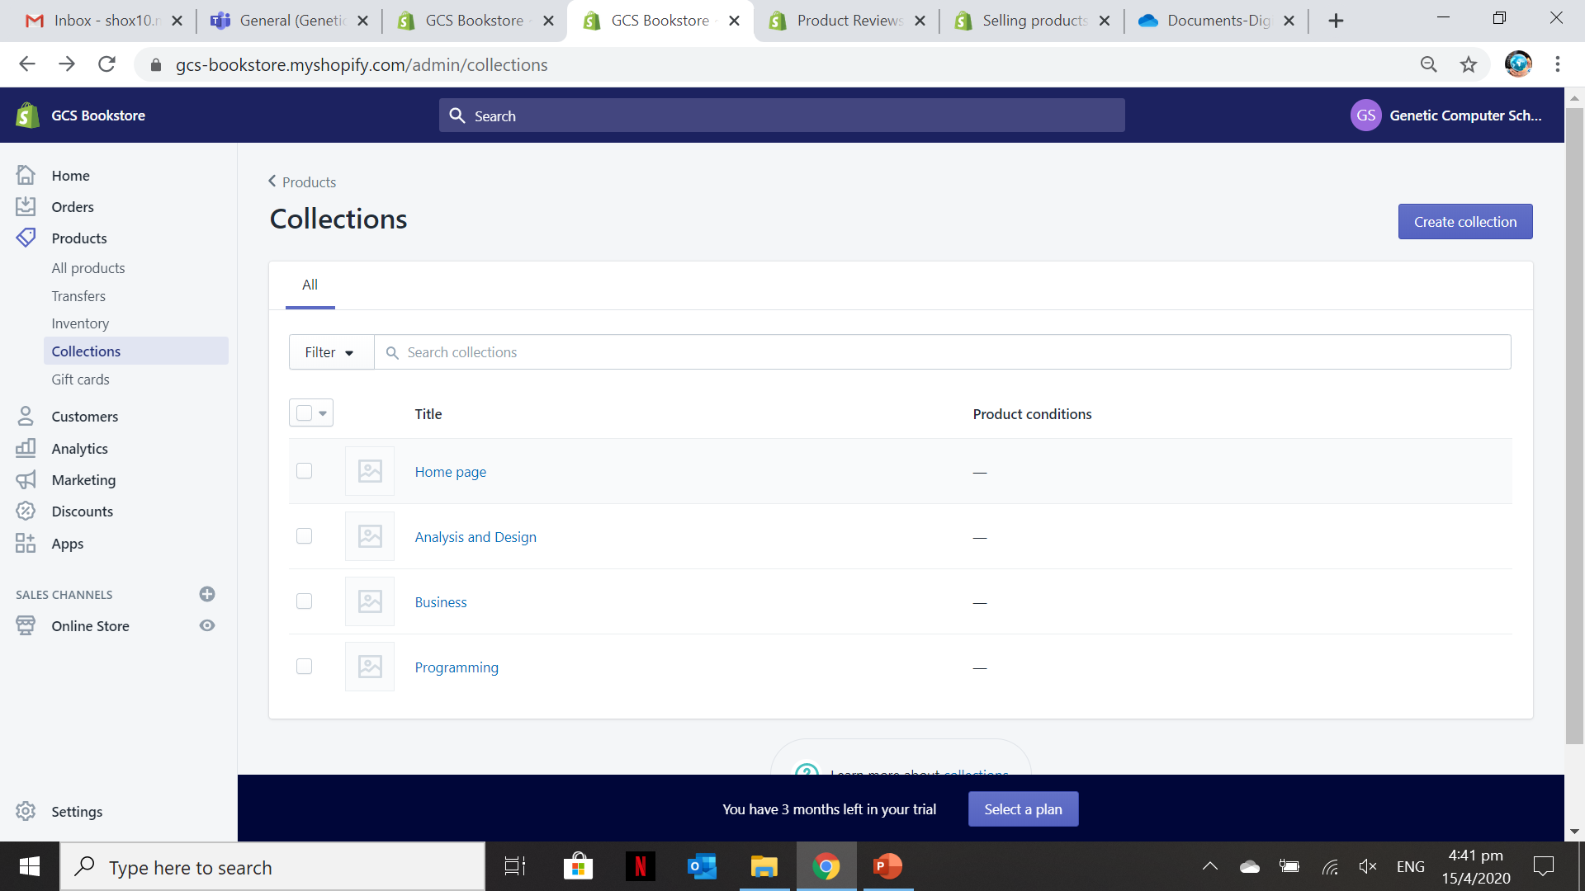
Manage Products 1 – Collections
A collection is used to categorize the products or services provided by your Shopify site

Slide 5
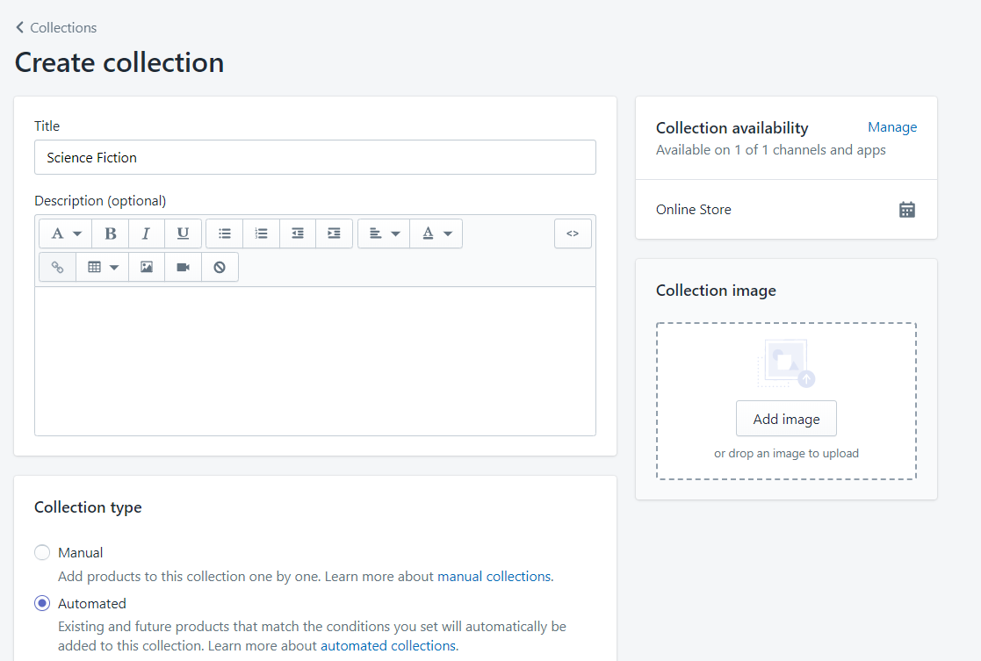
Manage Products 1 – Collections
Allows you to provide the details of the Collection
Manual – when the product is added, you need to select manually the collection. Automatic – the product is categorize automatically based on the given condition (E.g. tags or other conditions)
It is useful to upload an image for the created collection because this will be used to display in the homepage under “Feature Collections”
1
3
2

Slide 6
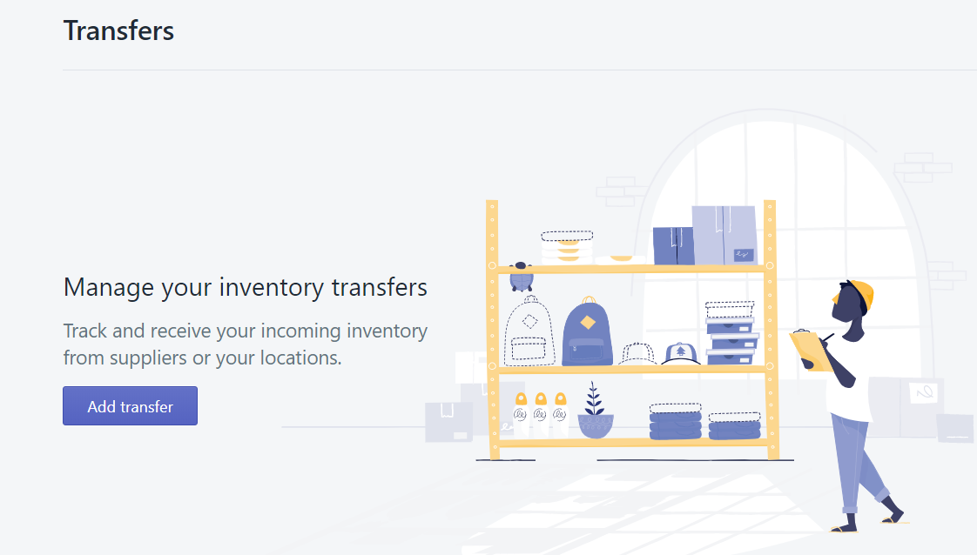
Manage Products 2 – Transfers
Managing the transfers allows you to track and receive your physical products from supplier in your locations.
So it is important to properly fill your location in future Shopify site.

Slide 7
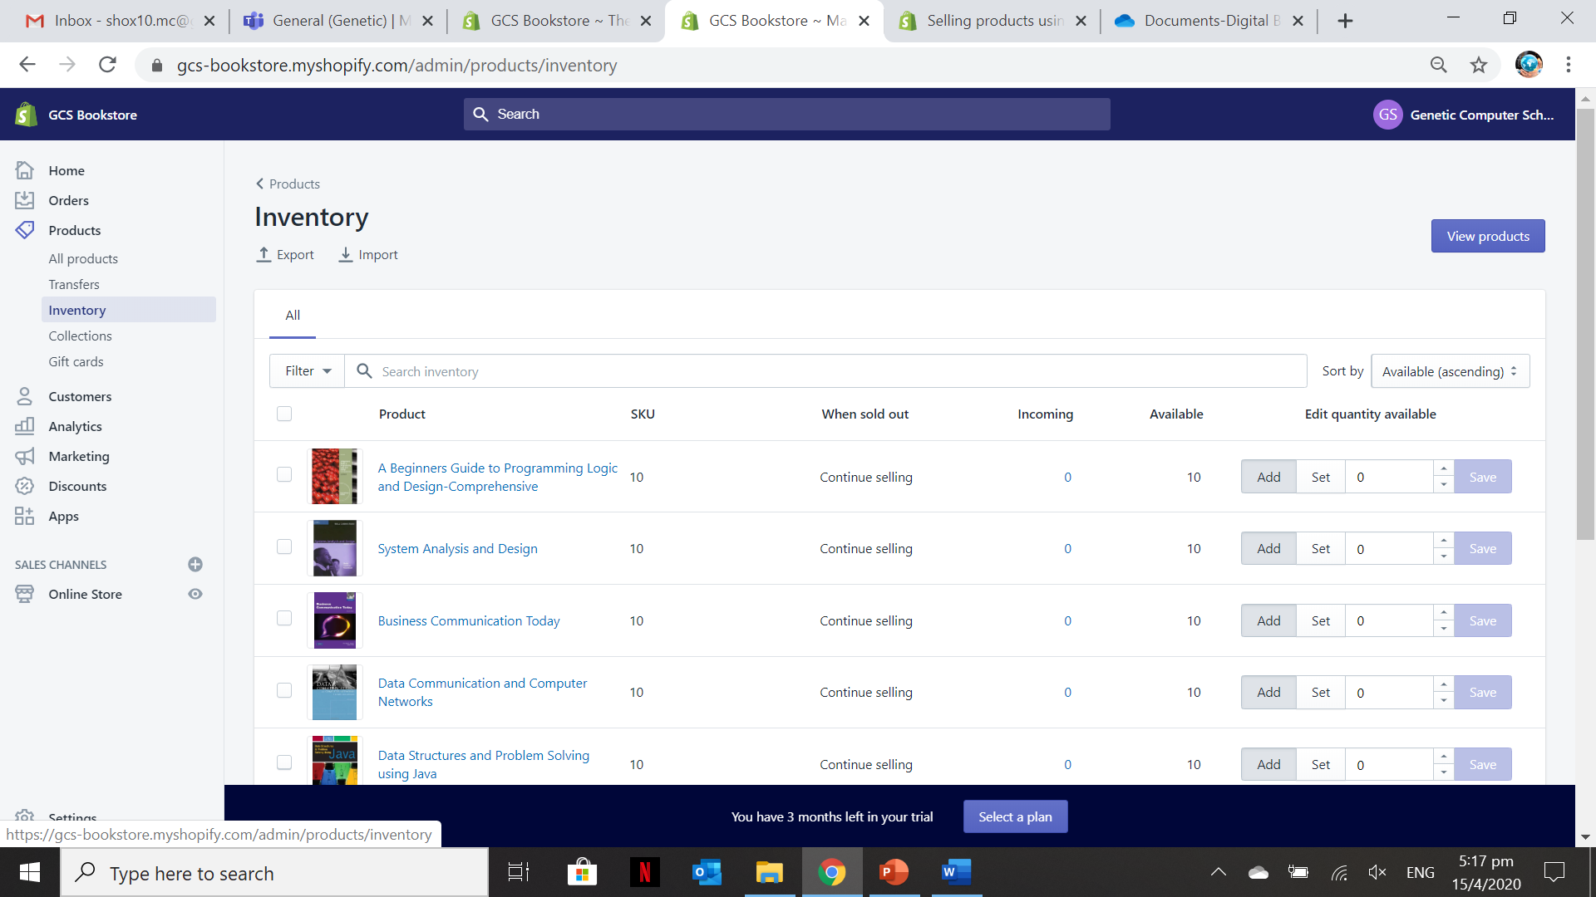
Manage Products 3 – Inventory
1
2
The value of the incoming will automatically change if the Product “Transfer” is configured
Can manually change the quantity of available products online. The values filled in the section will add into the available products.

Slide 8
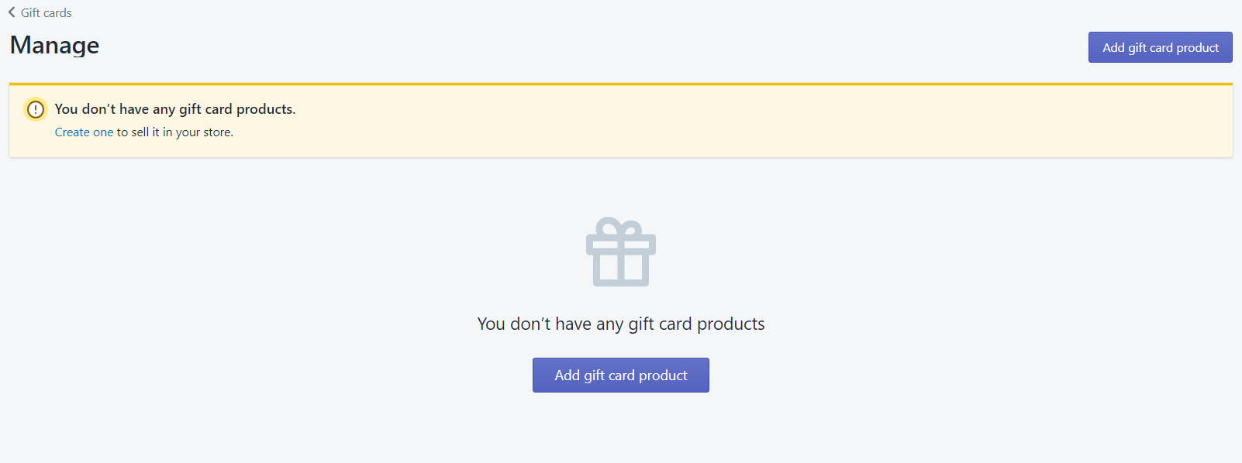
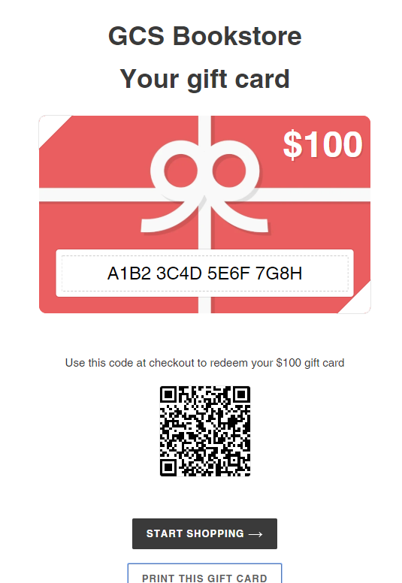
Manage Products 4 – Gift Cards
The sample gift card generated
You can customize the added gift card and generate different denominations. The gift card can also be issued to a specific customer.
Gift cards is considered another product which you can sell. Your customer can use it to purchase the products.

Slide 9
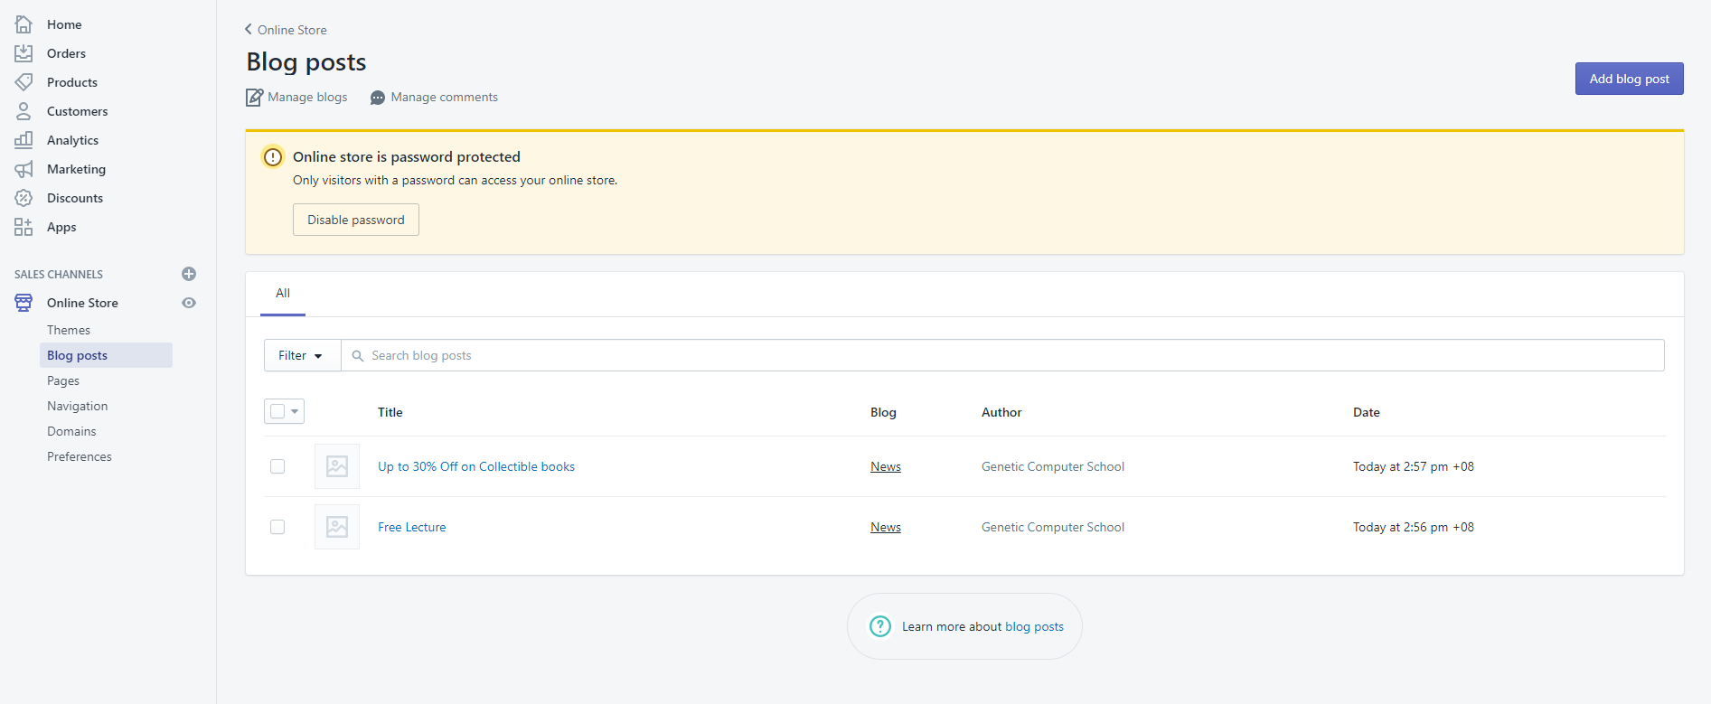
Manage Blogs
Benefits of Blogs in a site:
It helps drive web traffic
It helps convert traffic into leads
It creates value for your customers
SEO ranking and more

Slide 10
Activity 9.2
Refer to your book for Activity 9.2

Slide 11
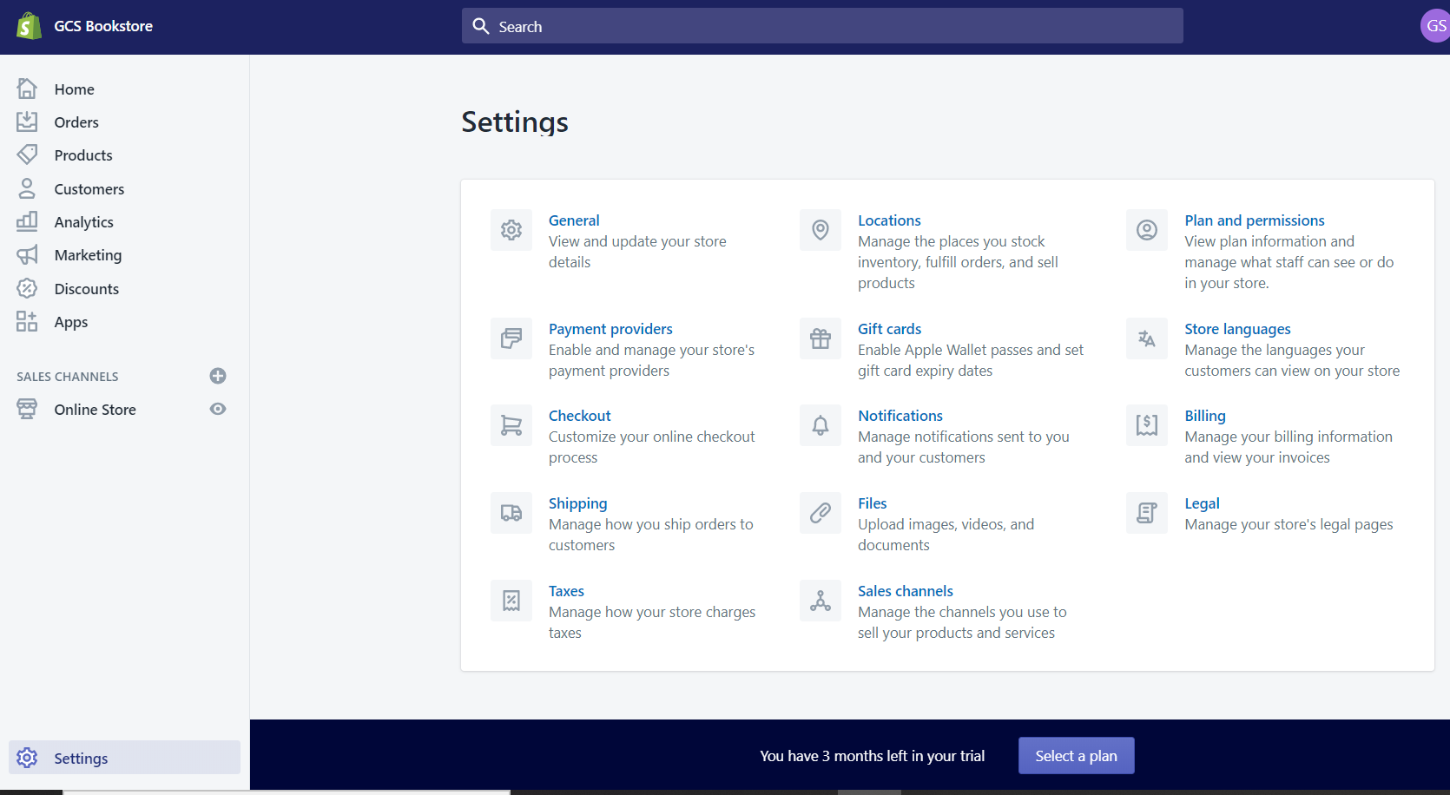
Other Shopify Settings 1 - Shipping
In this section, you can configure how orders are shipped to the customers. Like shipping rates at checkout, packages, packing slips and account integration

Slide 12
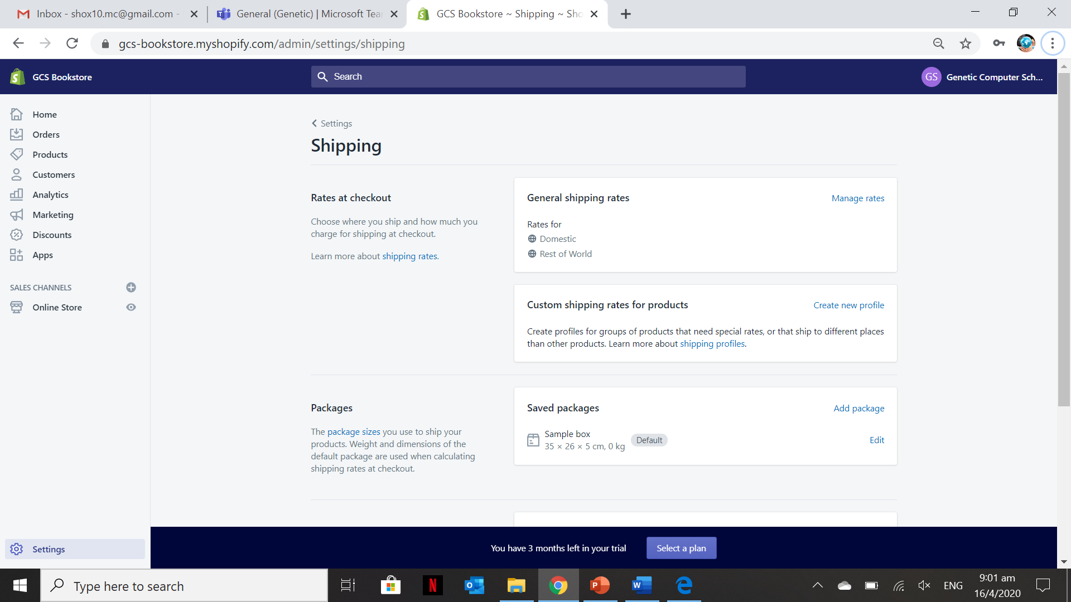
Other Shopify Settings 1 - Shipping
Can set the rates for both domestic and international. To edit the information you can click the “Manage Rates”

Slide 13
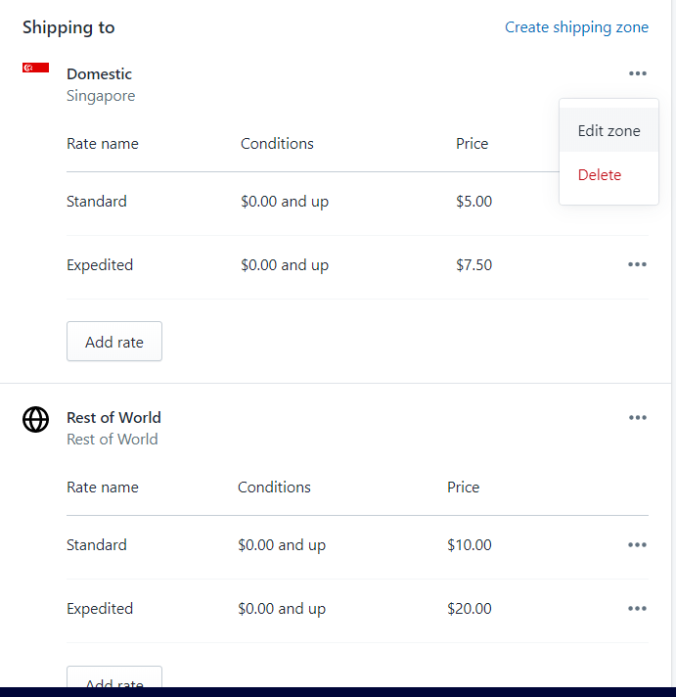
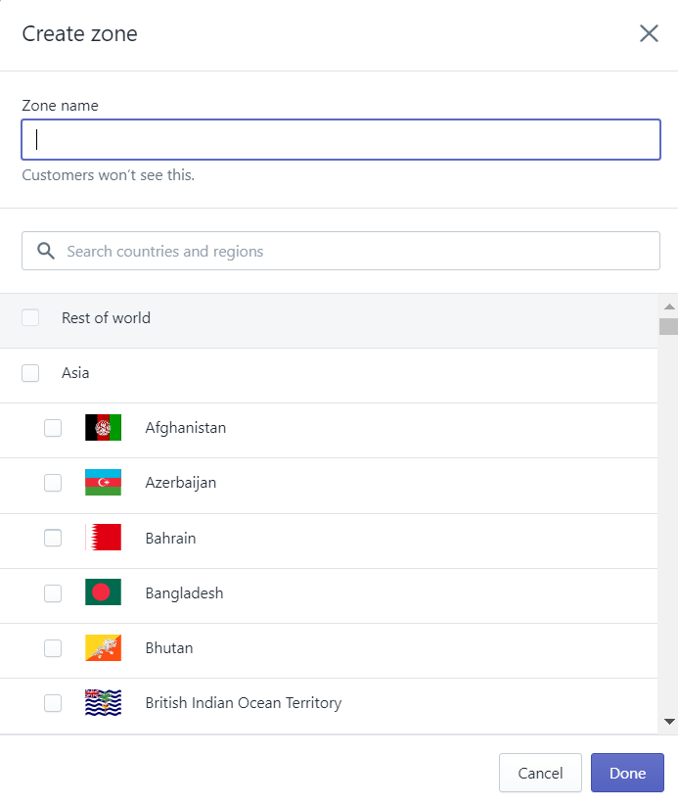
Other Shopify Settings 1 – Shipping (Editing Zone)
In this section, you can create a zone from which you can only ship the products/services

Slide 14

Other Shopify Settings 1 – Shipping (Editing Zone)
You can edit the “Domestic” zone into another country by clicking the “Edit zone”

Slide 15
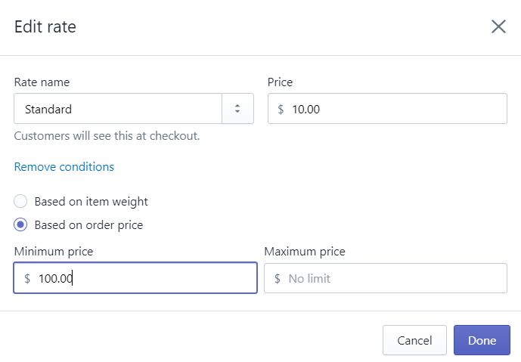

Other Shopify Settings 1 – Shipping (Editing Rate)
By default there are two types of rates “Standard” and “Expedited” for both domestic and rest of the world but you can add other rate information.
You can based the rate by “Item weight” or “Order Price”.

Slide 16
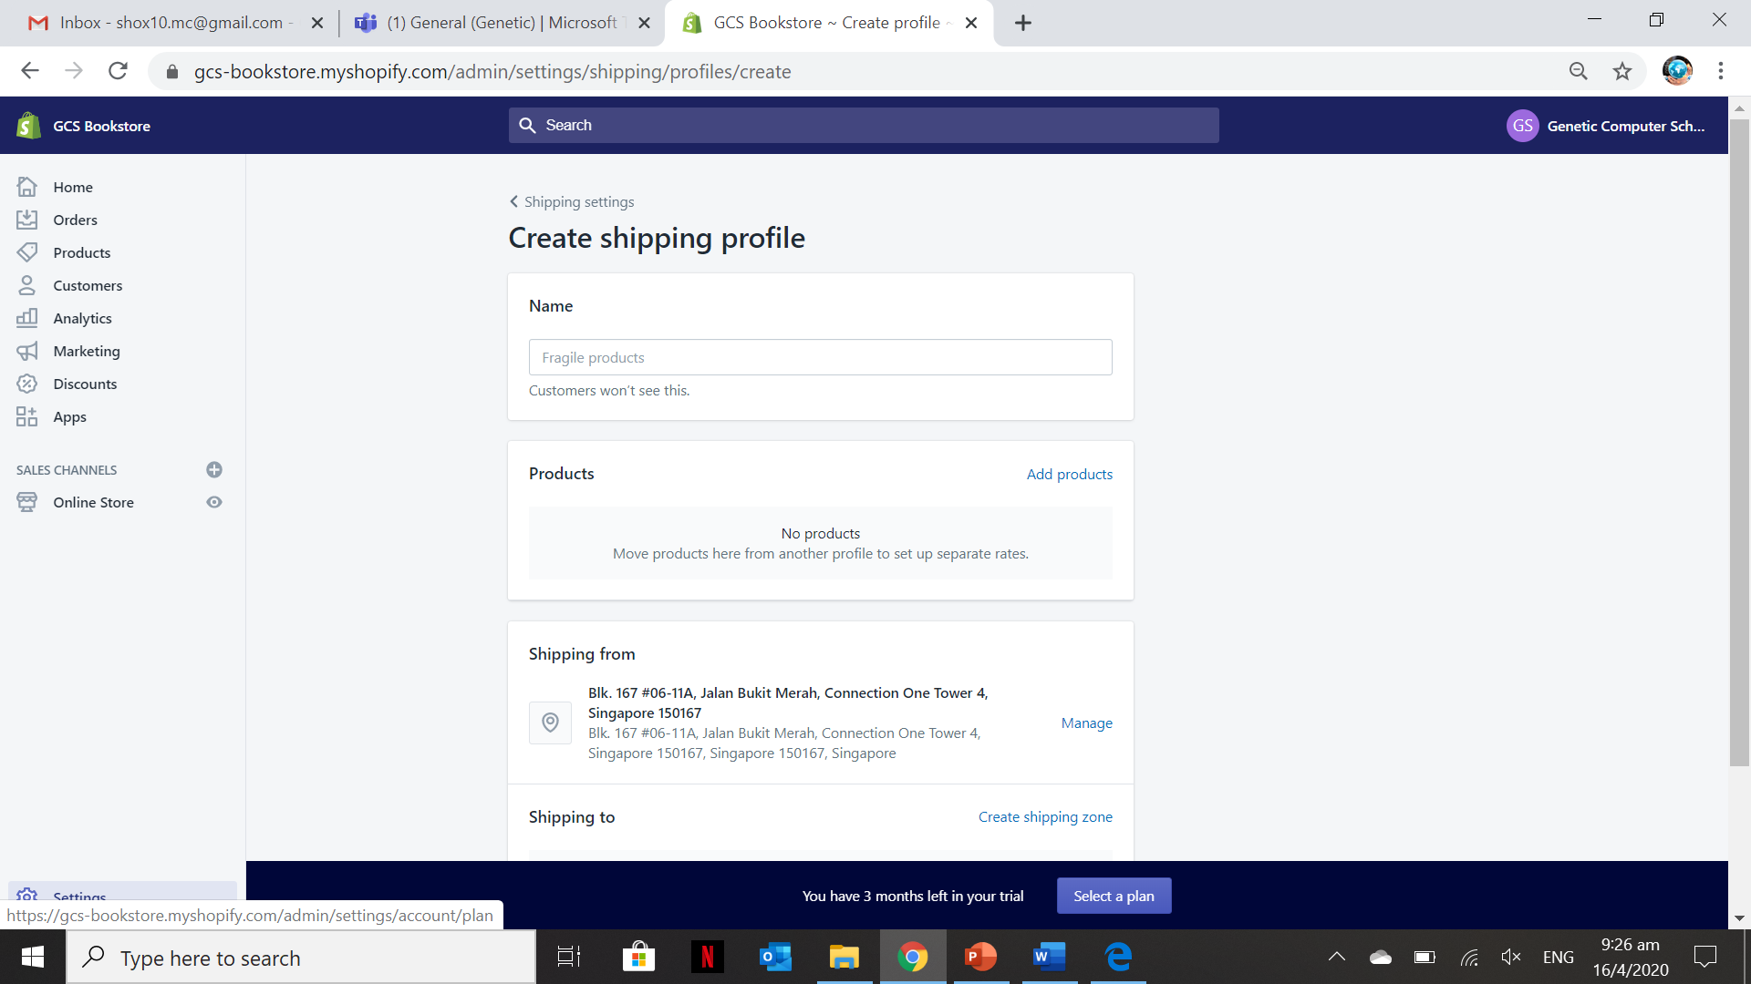
Other Shopify Settings 1 – Shipping (Editing Rate)
In this section, you can specify which products are fragile so that during shipping this will be noted and placed with a fragile label.
In this section, you can set specific rates for different products/services

Slide 17
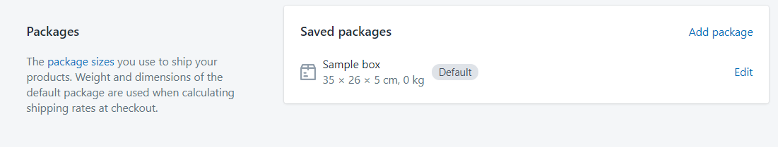
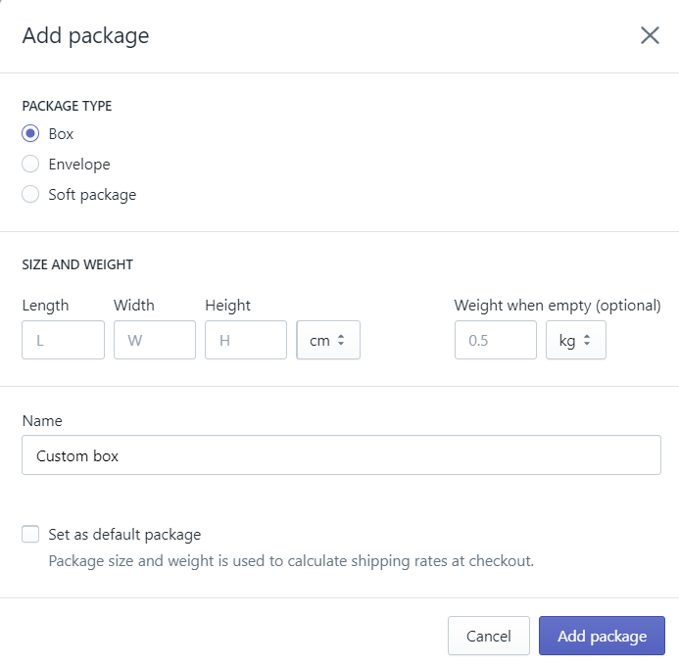
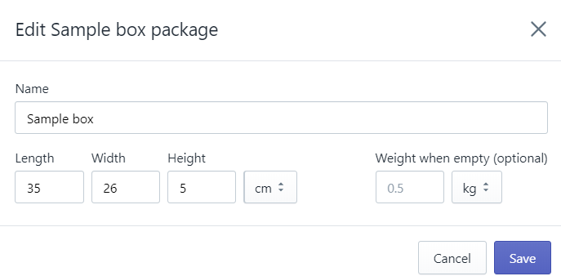
Other Shopify Settings 1 – Shipping (Packages)
For setting the packages sizes for products that are ordered by the customers

Slide 18

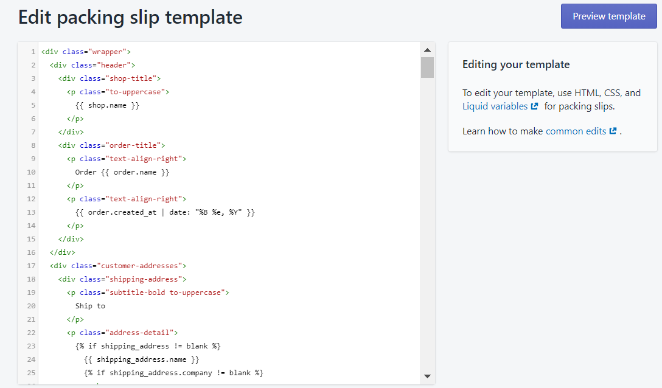
Other Shopify Settings 1 – Shipping (Packing Slip Customization)
It is an HTML format which you can edit and specify the From and To shipping addresses and the order details.

Slide 19
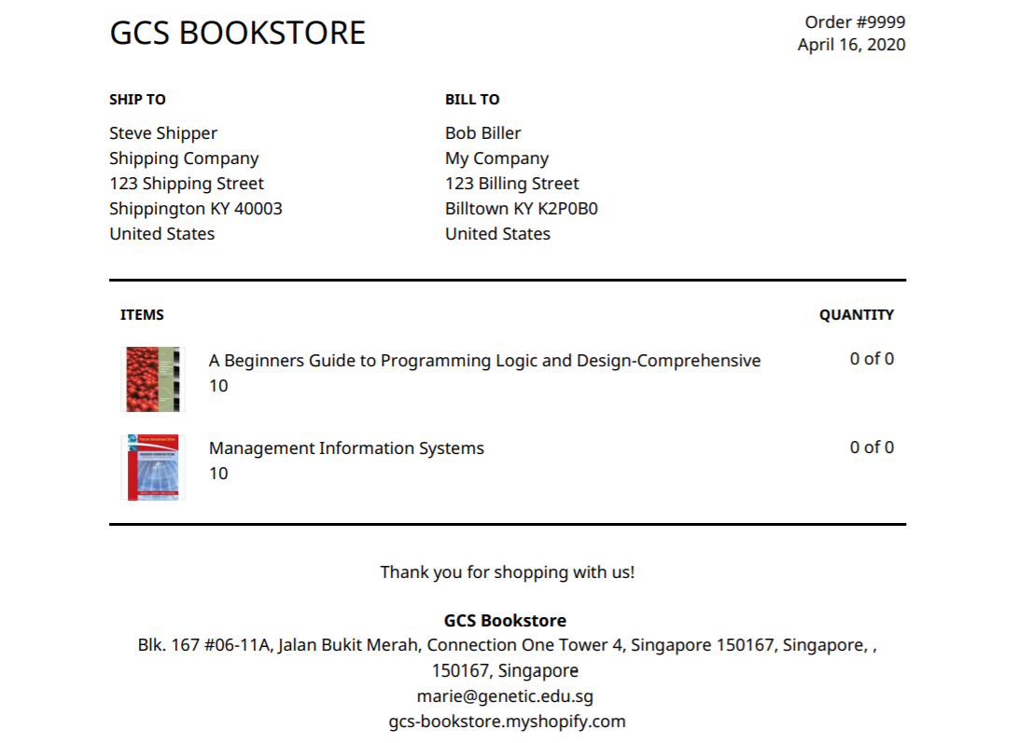
Other Shopify Settings 1 – Shipping (Packing Slip Customization)
Sample Customizable Template

Slide 20
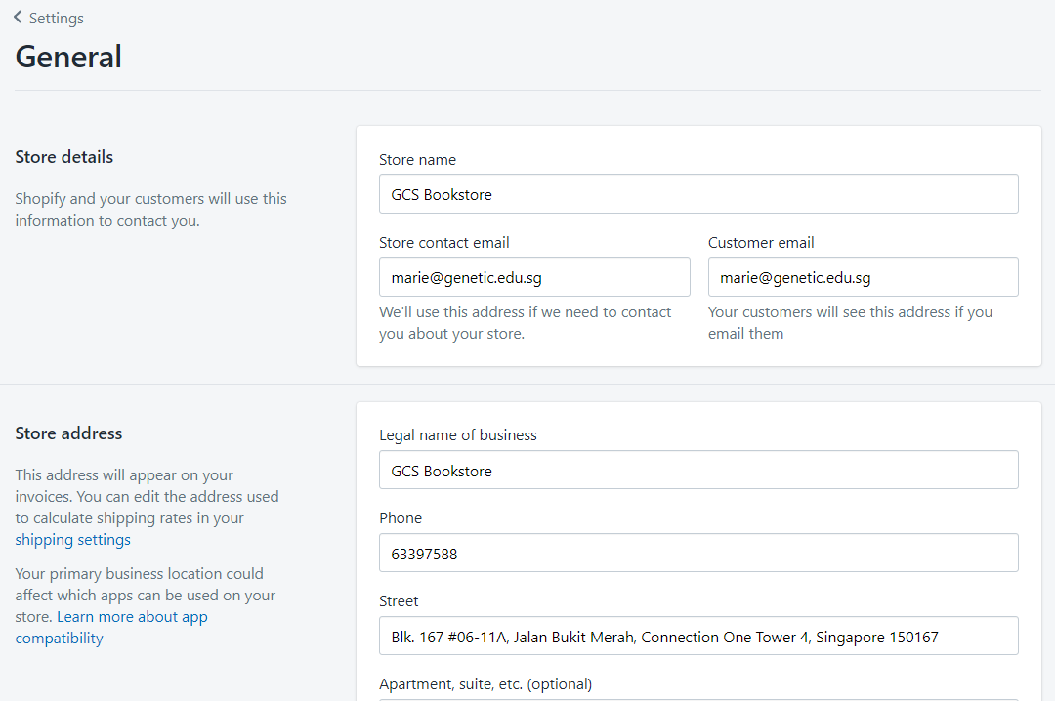
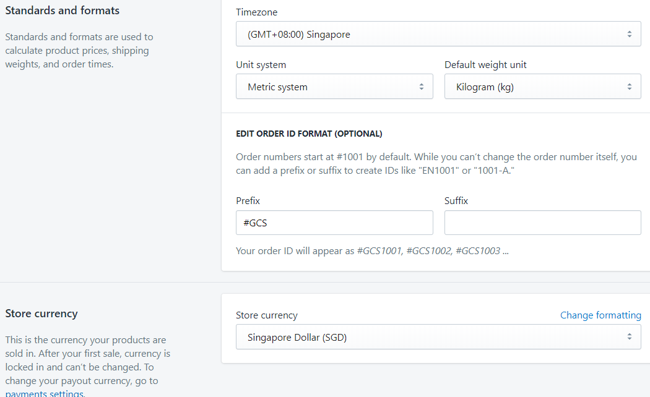
Other Shopify Settings 1 – Shipping (Packing Slip Customization)
To Change Store Address go to Settings > General

Slide 21
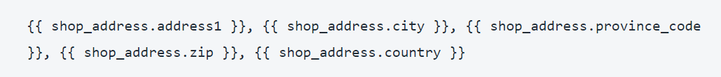
Other Shopify Settings 1 – Shipping (Packing Slip Customization)
To Change the Address on the Packing Slip go to Settings > Shipping > Packing List then click Edit
1. Find the following Liquid variables that reference your store address:
2. Highlight this code and delete it.
3. Type the address you want
4. Click Preview Template to see the changes
5. Click Save

Slide 22
Other Shopify Settings 1 – Shipping (Packing Slip Customization)
To Edit Logo in the Packing Slip
Before you add your store logo to your packing slips, you need to upload your logo to your Shopify admin. You need the URL that is assigned to your file to use on your packing slips.
Steps:
From your Shopify admin, go to Settings > Files.
Click Upload files.
Select and upload your store logo from your device.
Copy the file URL when the upload is complete.

Slide 23
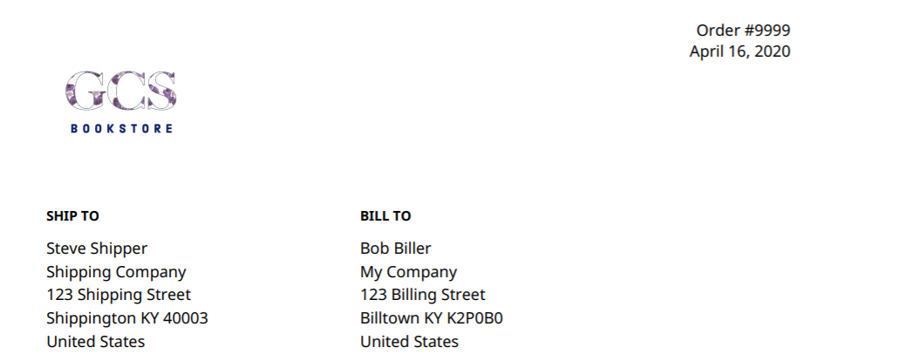
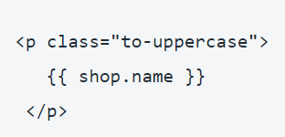
Other Shopify Settings 1 – Shipping (Packing Slip Customization)
To Add a Logo and remove the store name
You can remove your store name and replace it with your store logo at the top of your packing slips.
Steps:
From your Shopify admin, go to Settings > Shipping.
In the Packing slips section, click Edit.
Find the following code that references your store name:
Highlight the code and delete it
In the space created, write the following code below but take note to change URL:
<img src = “Paste the URL of the Logo” style=“width: 150px; height:150px;”>

Slide 24
Activity 9.3
Refer to your book for Activity 9.3

Slide 25
Other Shopify Settings 2 – Payment Providers
In this section, you can configure and manage the payment providers

Slide 26
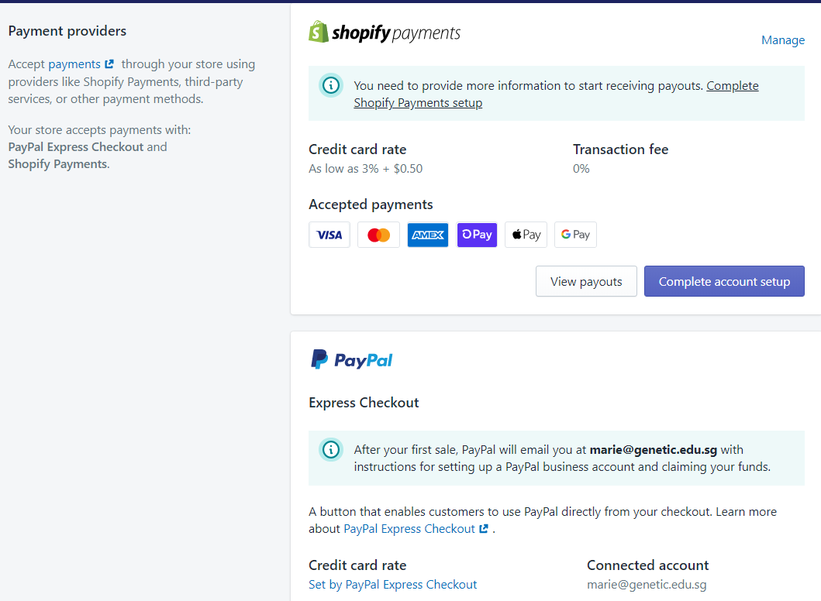
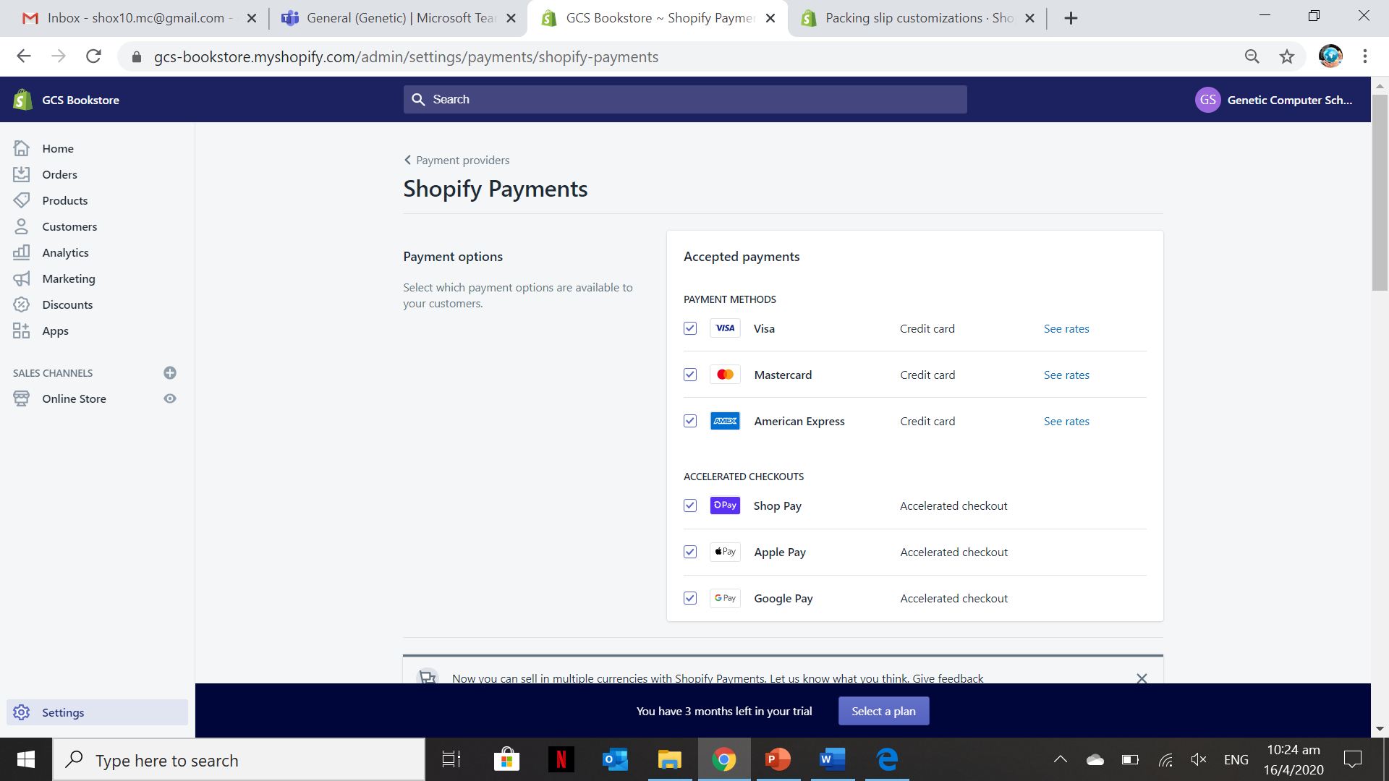
Other Shopify Settings 2 – Payment Providers
Available Payment Providers. You can select and deselect each payment provider. You can enable test mode to simulate successful and failed transactions

Slide 27
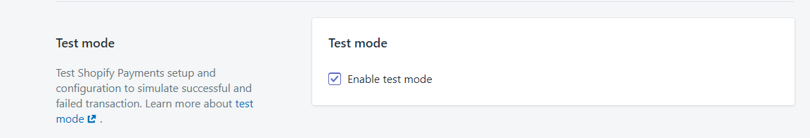
Other Shopify Settings 2 – Payment Providers
To test your Shopify Payments setup and configuration, you can “Enable Test Mode” to simulate successful and failed transactions.
For more information on enabling test mode watch the video below:
https://youtu.be/yOg0lpBt6d0

Slide 28
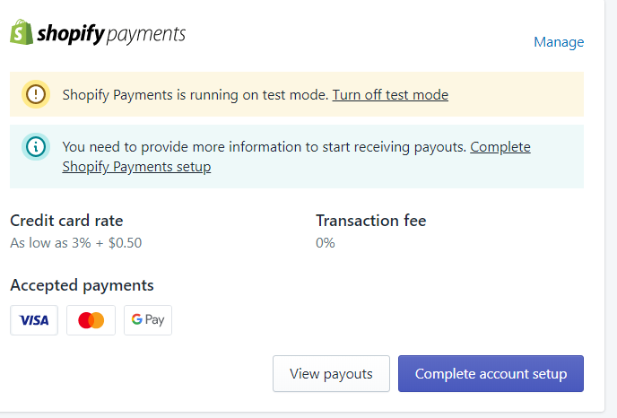
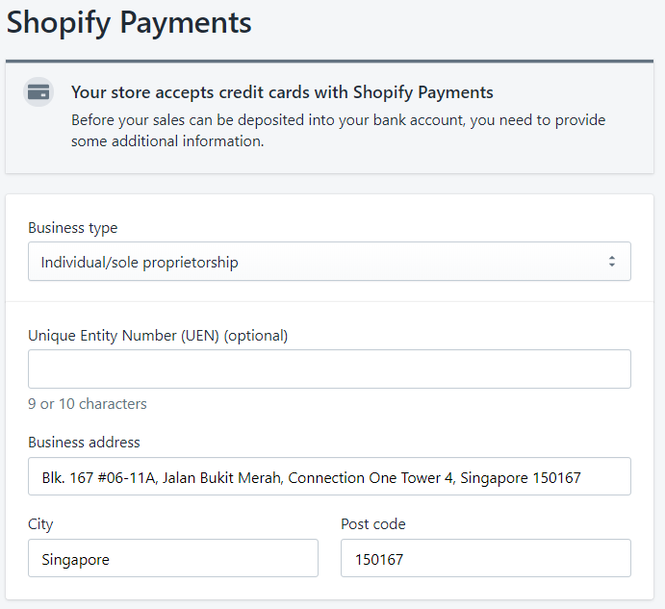
Other Shopify Settings 2 – Payment Providers (Account Payment Setup)
Provide the necessary company/business information

Slide 29
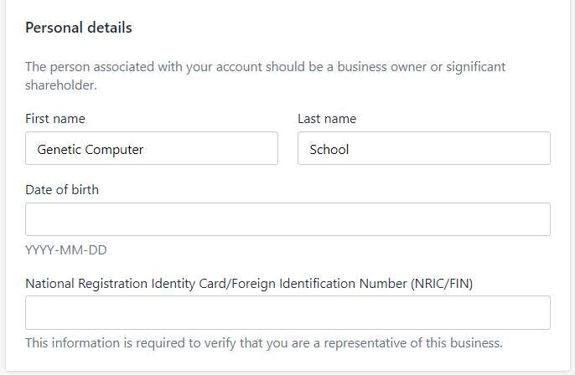
Other Shopify Settings 2 – Payment Providers (Account Payment Setup)
Provide the business/company owner or significant shareholders information

Slide 30
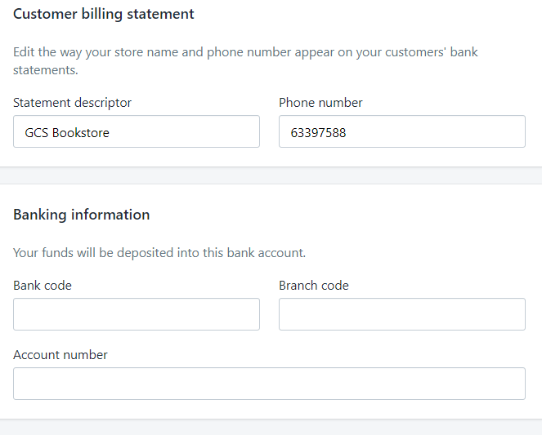
Other Shopify Settings 2 – Payment Providers (Account Payment Setup)
The Banking information is very important because the funds will be deposited into this account

Slide 31
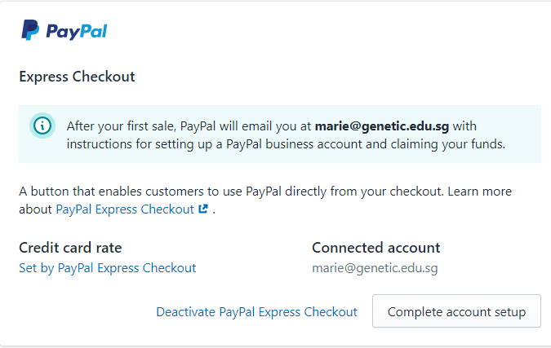
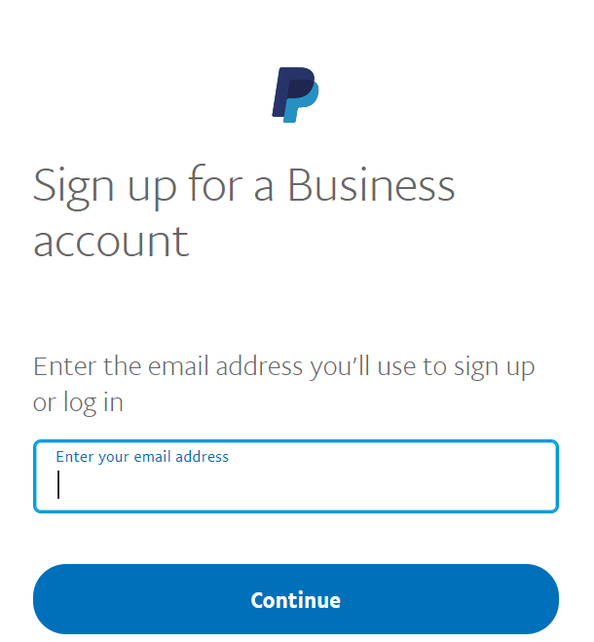
Other Shopify Settings 2 – Payment Providers (PayPal Complete Setup)
Redirected to PayPal portal to set-up a business account.

Slide 32
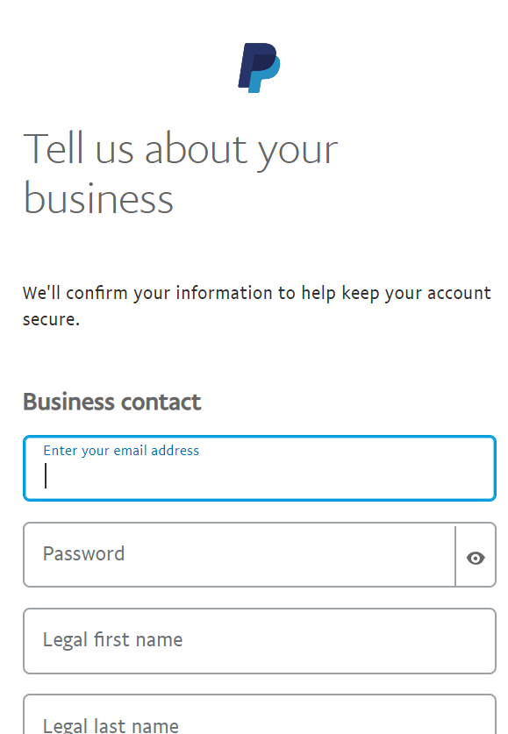
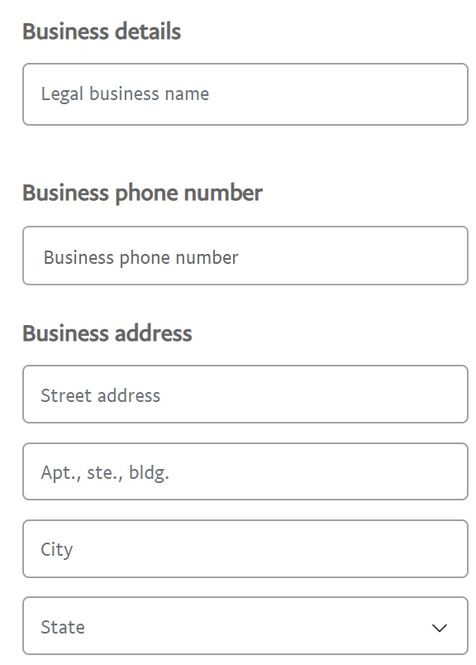
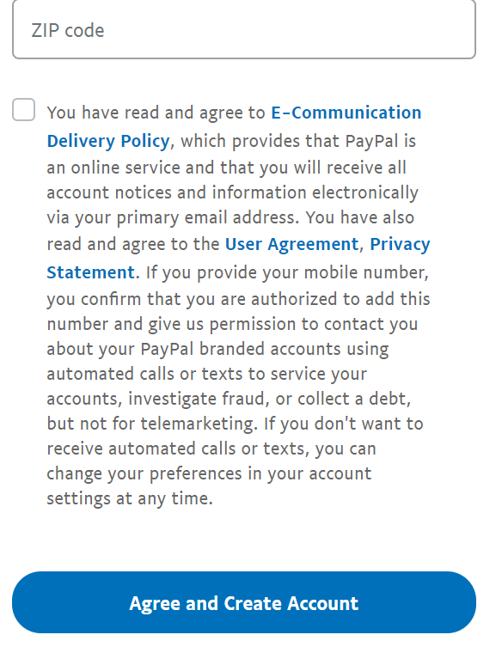
Other Shopify Settings 2 – Payment Providers (PayPal Complete Setup)

Slide 33
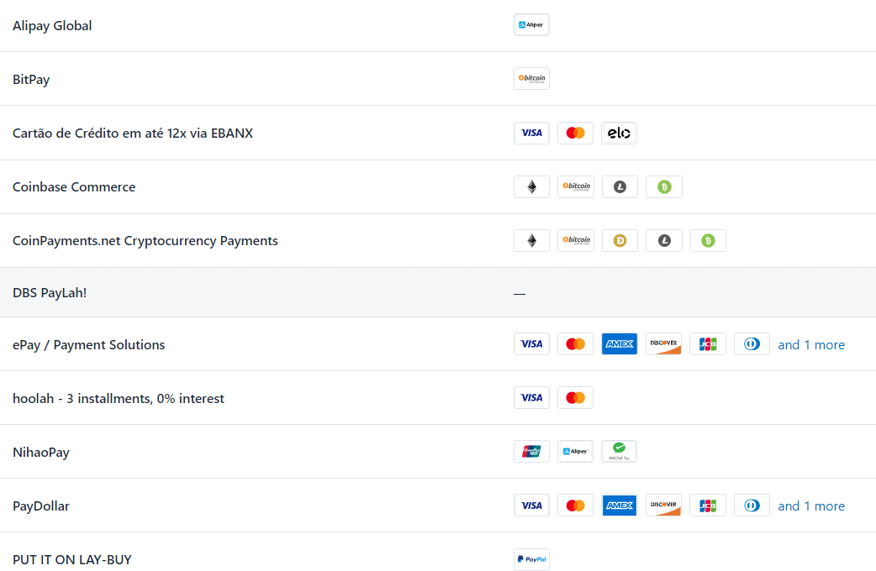
Other Shopify Settings 2 – Payment Providers (Alternative Payment Methods)
Alternative Payment methods in Shopify Payment which you can choose from.

Slide 34
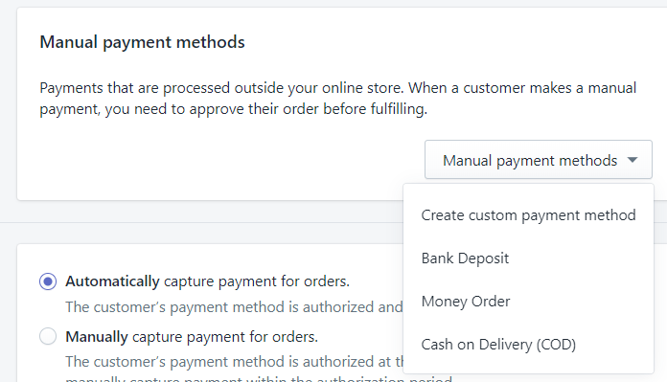
Other Shopify Settings 2 – Payment Providers (Manual Payment Methods)
In this section, you configure a manual payment method for the customers.

Slide 35

Other Shopify Settings 2 – Payment Providers (Payment Capture)
Most of Shopify site charge credit cards and/or other payment methods automatically the moment the customer’s payment method is authorized. But you opt to do it manually but it will be tedious on the company’s side.

Slide 36
Activity 9.4
Refer to your book for Activity 9.4

Slide 37
Other Shopify Settings 3 – Checkout
In this section, you can configure and manage checkout settings like customer accounts, Customer contact, form options and order processing, email marketing and Checkout language

Slide 38
Other Shopify Settings 3 – Checkout
During the trial period, the checkout is deactivated by default. In order to activate this, to test out all the features available you will just need to select your preferred plan.

Slide 39
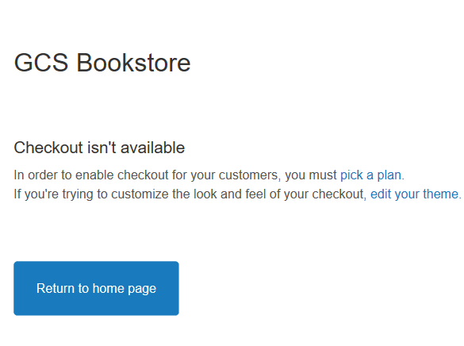
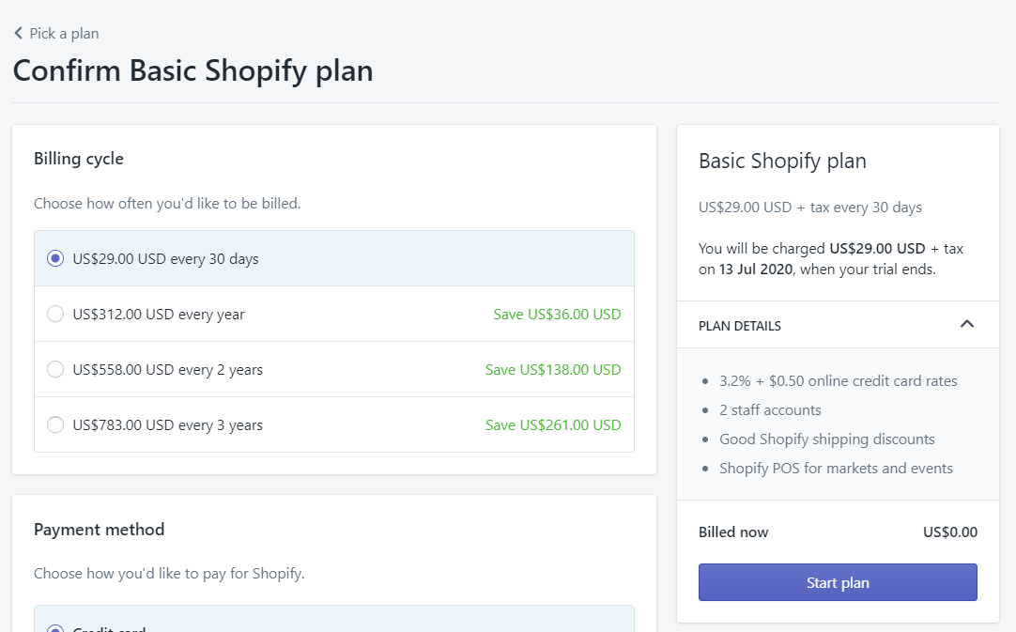
Other Shopify Settings 3 – Checkout
When you click the “Checkout” this is the message you will receive from your screen if you didn’t pick or select a plan. However after you select the plan, this will not be charged right away only after the free trial period expires.

Slide 40
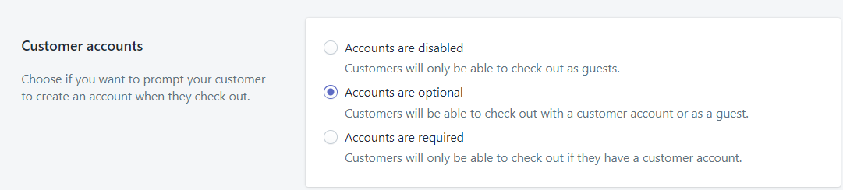
Other Shopify Settings 3 – Checkout (Customer Accounts)
In this section, there are three settings you can choose from. If your company/business requires users to have an account then select the third one but majority of the Shopify site selects the “Accounts are optional” to give flexibility on your customers. Sometimes they don’t want the site to capture permanently their information.

Slide 41
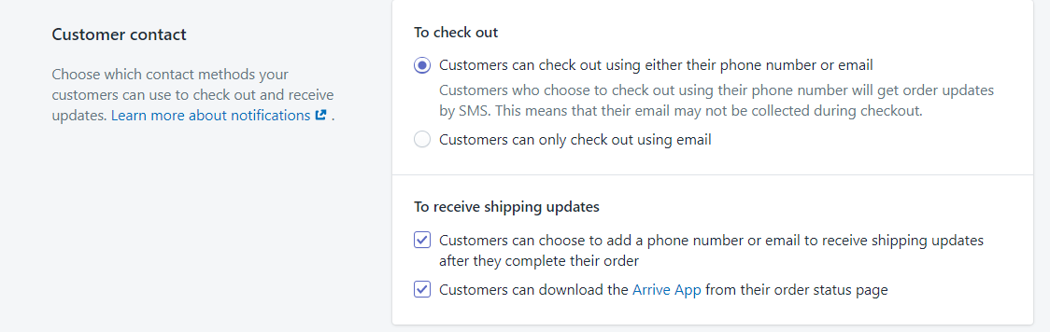
Other Shopify Settings 3 – Checkout (Customer Accounts)
In this section, you can configure whether the customers can use either phone numbers or e-mail and to receive shipping updates through e-mail/phone or check in the “Arrive App” for the status of the order

Slide 42
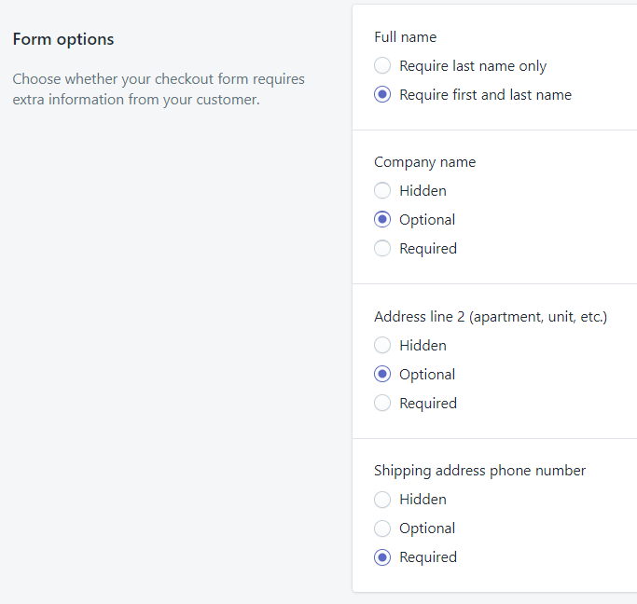
Other Shopify Settings 3 – Checkout (Form Options)
Settings that allows the customers to fill up their information like FirstName, LastName or both
Settings that allows the customers to provide their company name but not all customers has company so normally it is set to hidden or optional
Settings that allows the customers to provide a second address or not. Normally it is set to optional
Settings that allows the customers to provide a shipping address and phone number. Normally it is set to required

Slide 43
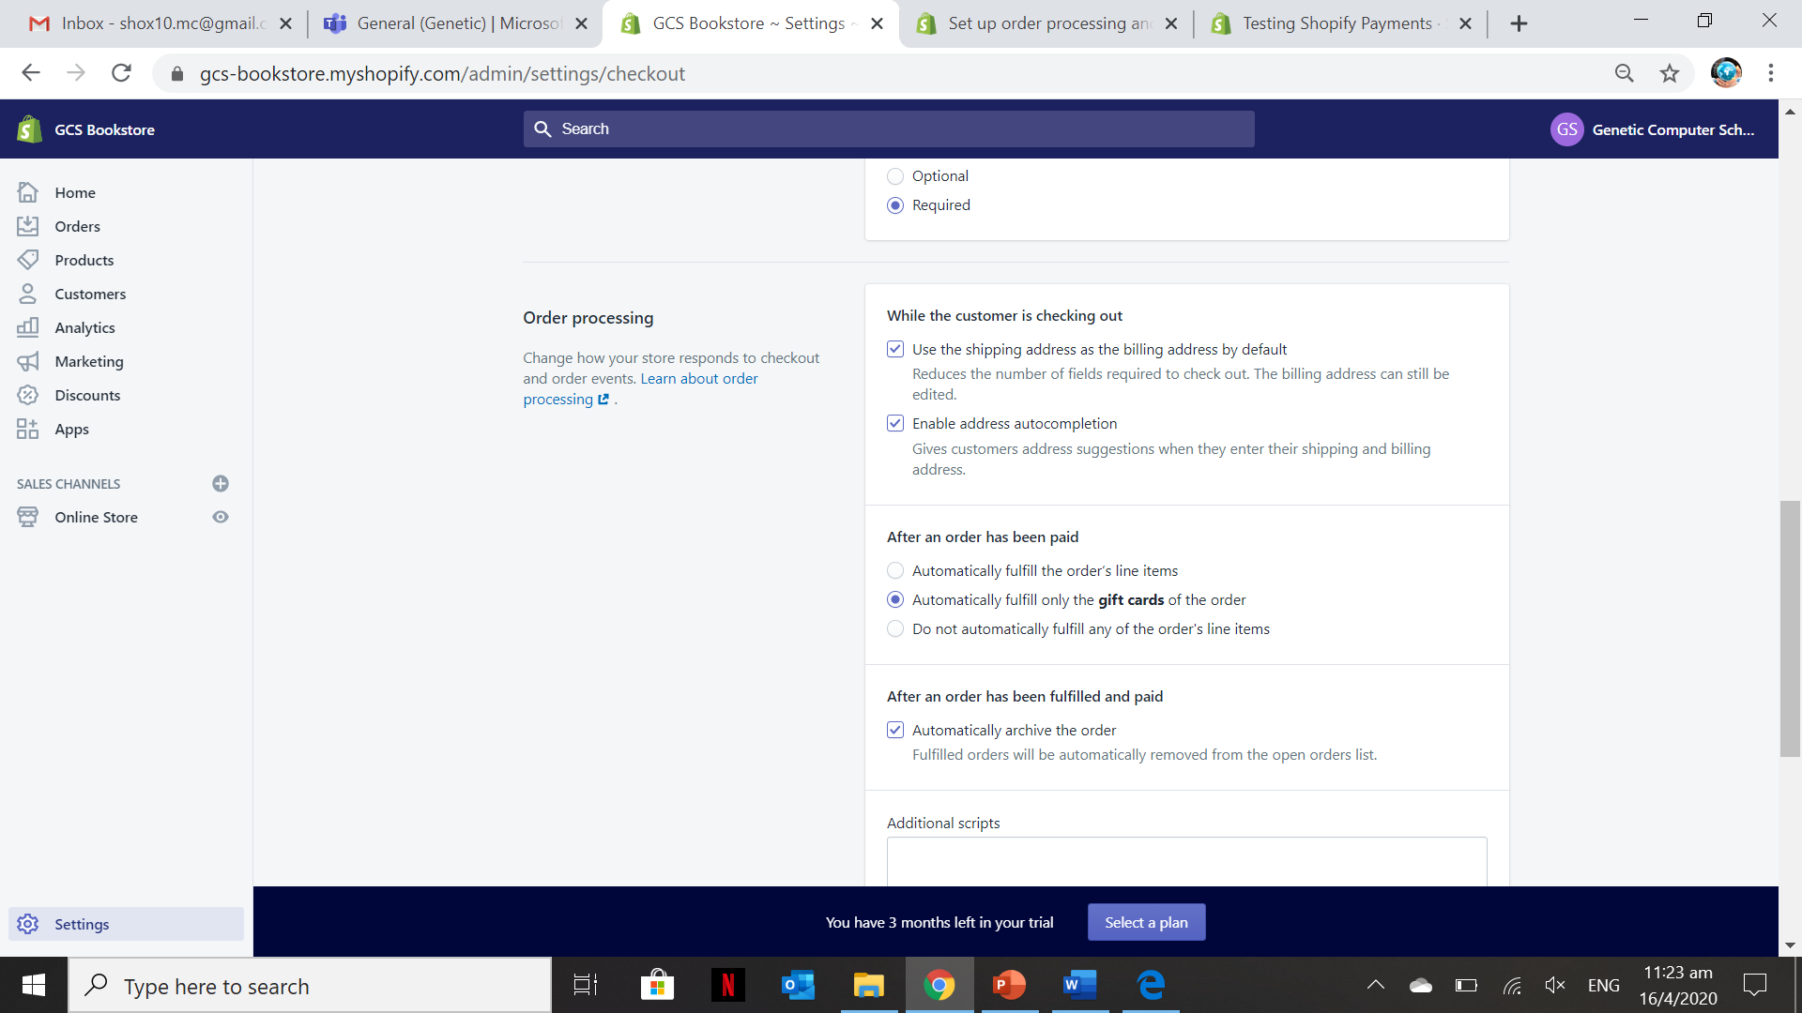
Other Shopify Settings 3 – Checkout (Order Processing)
When you fulfill an order in Shopify, you begin the process of sending the order on its way to the customer. The customer receives an email telling them that their item has shipped, and the order's Fulfillment Status displays as Fulfilled on the Orders page.
You can set up automatic or manual fulfillment for orders and order archiving from the checkout settings page in Shopify.
When you

Slide 44
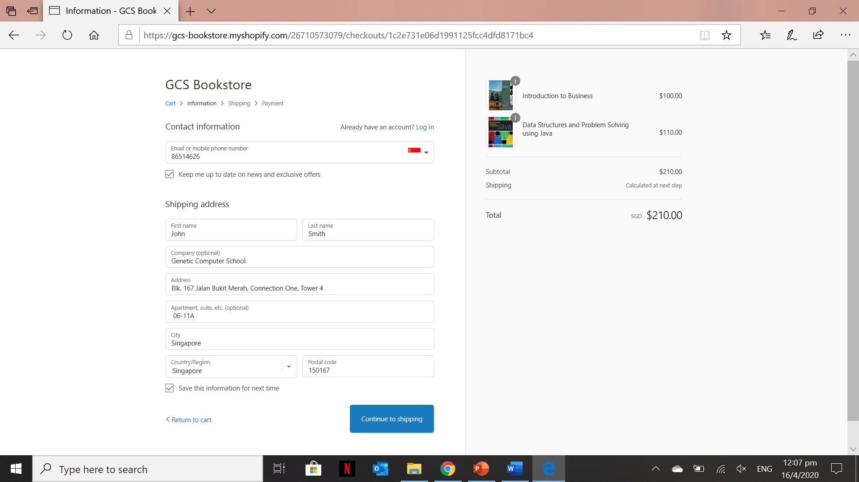
Other Shopify Settings 3 – Checkout (Order Testing and Checkout)
Take note that this will only be available when you selected a plan and enabled the test mode. Whatever you see on this page is because of the configure checkout setting.

Slide 45
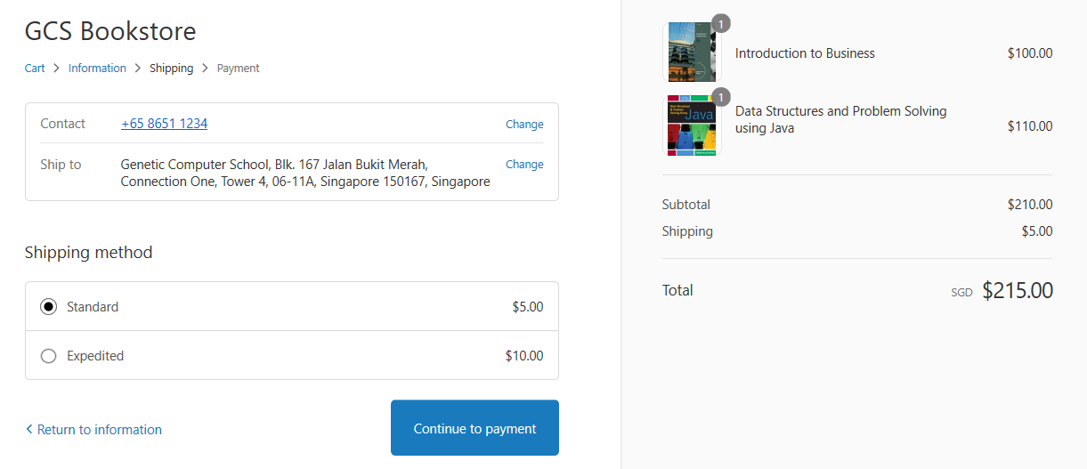
Other Shopify Settings 3 – Checkout (Order Testing and Checkout)

Slide 46
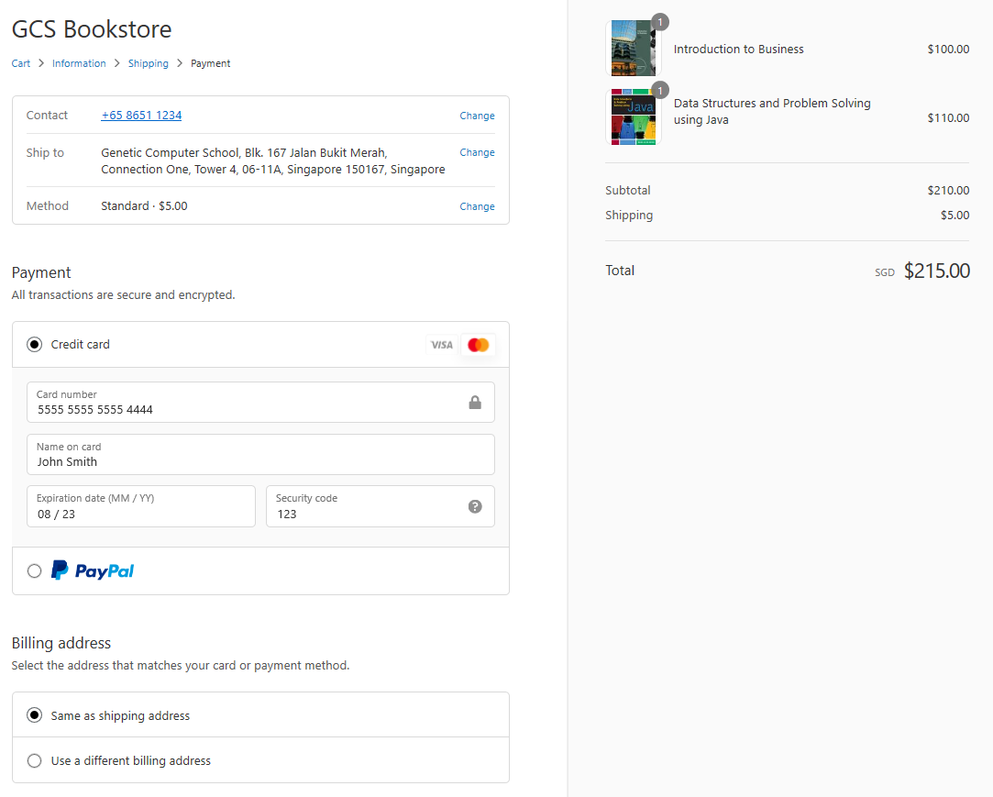
Other Shopify Settings 3 – Checkout (Order Testing and Checkout)
Dummy credit card account information provided by Shopify to simulate successful and failed transactions.

Slide 47
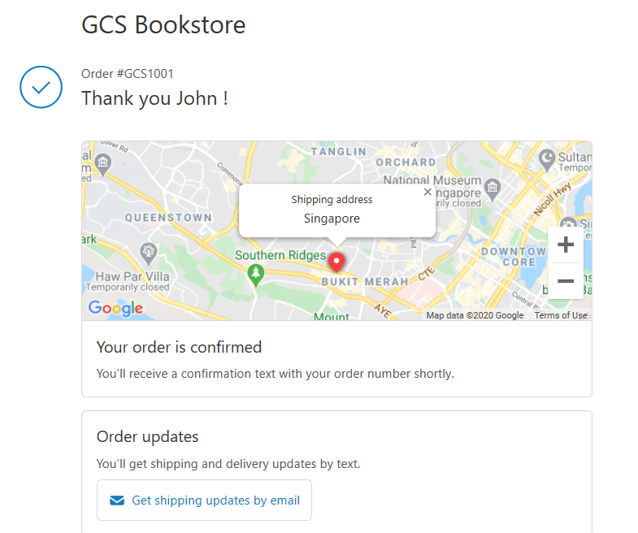
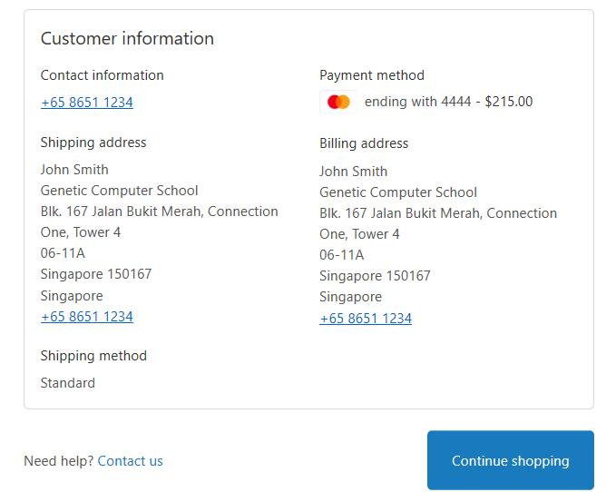
Other Shopify Settings 3 – Checkout (Order Testing and Checkout)
Order confirmation and notification letter of the transaction

Slide 48
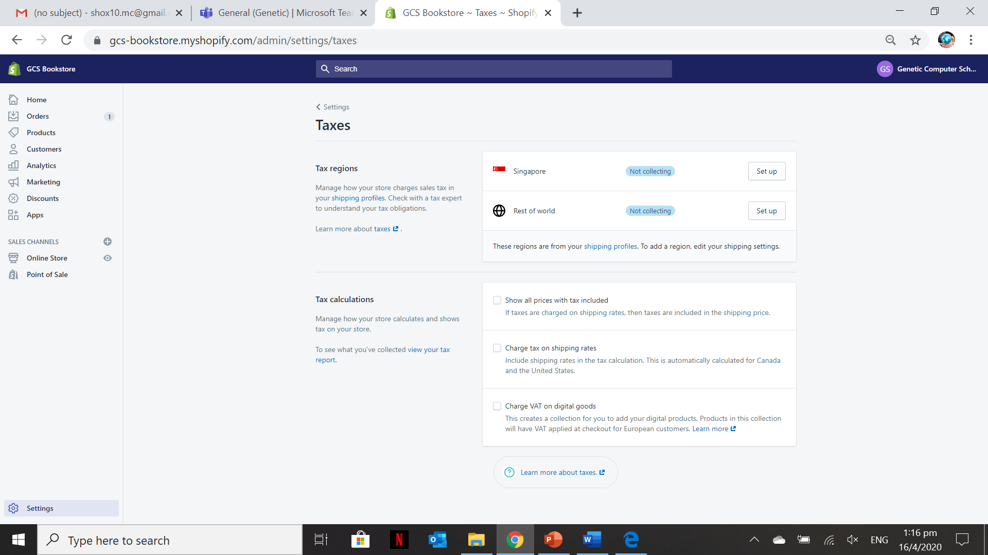
Other Shopify Settings 4 – Taxes
In this section, you can configure the taxes for both domestic or Rest of the world

Slide 49
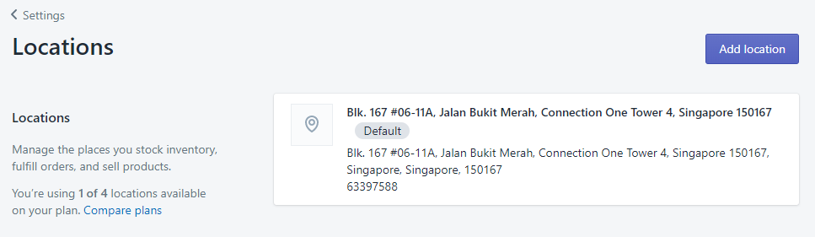
Other Shopify Settings 5 – Locations
In this section, you can configure and add location to stock inventory, fulfil orders and sell products.

Slide 50
Other Shopify Settings 6 – Gift Cards
In this section, you can set the expiry of a gift and enable Apple wallet

Slide 51
Other Shopify Settings 7 – Notifications
In this section, you can customize notifications to customers like Order Confirmation, Order cancelled, order refund, shipping confirmation, and etc.

Slide 52

Other Shopify Settings 8 – Sales Channel
In this section, you can configure and add different sales channels like Facebook shop, Instagram, Messenger, and etc.

Slide 53
Other Shopify Settings 9 – Plan and Permission
In this section, you can view the plan details, set-up staff account and change the store status like pause your store or close your store.

Slide 54

Other Shopify Settings 9 – Plan and Permission
This section is very important since in this lesson we are using a free trial plan so if you don’t want your credit card to be charged with selected plan for testing the checkout purposes then you need to “Close the store” to not incur further charges.

Slide 55
Activity 9.5
Refer to your book for Activity 9.5

Slide 56

Manage Orders
In this section, you can manage the orders received from the customers and you will receive an e-mail notification from Shopify on your configured e-mail.

Slide 57

Manage Orders
E-mail notification for any orders received from the customers.

Slide 58

Manage Orders
Text Notification to the Customers after purchasing the products/services from the Shopify site.

Slide 59




Manage Orders

Slide 60

Manage Orders
Mark it as fulfilled if the items ordered by the customer is already delivered and/or fulfilled.

Slide 61


Manage Orders
In this section, you need to fill the shipping carrier and the tracking number. Click the “Fulfill Items” to fulfill the orders of the customer. Customer will be notified via SMS or email

Slide 62
Activity 9.6
Refer to your book for Activity 9.6

Slide 63


Manage Customers
To add a new customer click on “Add customer”

Slide 64

Shopify Analytics
Shopify's analytics and reports give you the means to review your store's recent activity, get insight into your visitors, and analyze your store's transactions.
Everyone can access the Overview dashboard and key financial reports. If you have an online store, then you can access Live View. If you're on the Basic Shopify plan or higher, then you can access more reports.

Slide 65

Marketing
You can create and manage marketing activities like Facebook ads and marketing automations like Google Smart Shopping campaigns from the Marketing page in Shopify. The Marketing page also includes recommendations to improve your marketing strategy.
You can also create marketing outside of Shopify using third-party services or apps, and view data about these activities in the service where you create them.

Slide 66

Discounts
In Shopify site, discounts are used to improve customer relationship. Discounts can be manually created or automatically generated

Slide 67

Discounts (Sample Automatic Discount)
This discount is automatic and applied to all purchases from the customers upon checkout and payment.

Slide 68

Discounts (Sample Automatic Discount)

Slide 69

Discounts (Sample Automatic Discount)

Slide 70

Discounts (Sample Automatic Discount)
The automatic discount is applied in the total amount of the order before checking out.

Slide 71

Shopify Apps
Available apps in Shopify that you can install for productivity purposes and your business products offerings and services.

Slide 72

Shopify Apps (Product Review App Installed)
This app allows the customer to give reviews and feedback about the products and services.

Slide 73

Shopify Apps (Product Review App Installed)
Install the App to add it in your Shopify site.

Slide 74

Shopify Apps (Product Review App Installed)
List all the reviews from the customers of the Shopify site.

Slide 75


Shopify Apps (Product Review App Installed)

Slide 76
Activity 9.7
Refer to your book for Activity 9.7

Slide 77
Portfolio – Other Shopify Settings, Configuration and Customization
The contents of your portfolio for this lesson are the following:
Two collections and added as the sub-menu of the products categories
Three blogs and one of the blogs is featured in the Home page
Configured other Shopify Settings (E.g. Shipping, Payments & etc.)
Fulfilled two sets of orders and perform checkout to simulate if transactions are successful or failed.
Created an Automatic discount
Installed one free app (E.g. Product Reviews, Order Printer & etc.)

